Slide 1



School of Information Technology
https://www.monash.edu.my/
FIT5226
Multi-agent System & Collective Behaviour
Week 3-1: Reinforcement Learning – Introduction Week 3-2: Bellman Equation, Policy and Value Iteration
FIT3155-S2-2024
Prepared by: Bernd Meyer. Edited by: Fuad Noman
www.monash.edu.au

Slide 2





Reinforcement Learning
Computer Science
Reinforcement Learning
Engineering
Machine Learning
Neuroscience
Optimal Control
Reward System
Operations Research
Classical/Operant Conditioning
Mathematics
Bounded Rationality
Psychology
Economics
8/7/2024
FIT5226-S2-2024
2/65

Slide 3
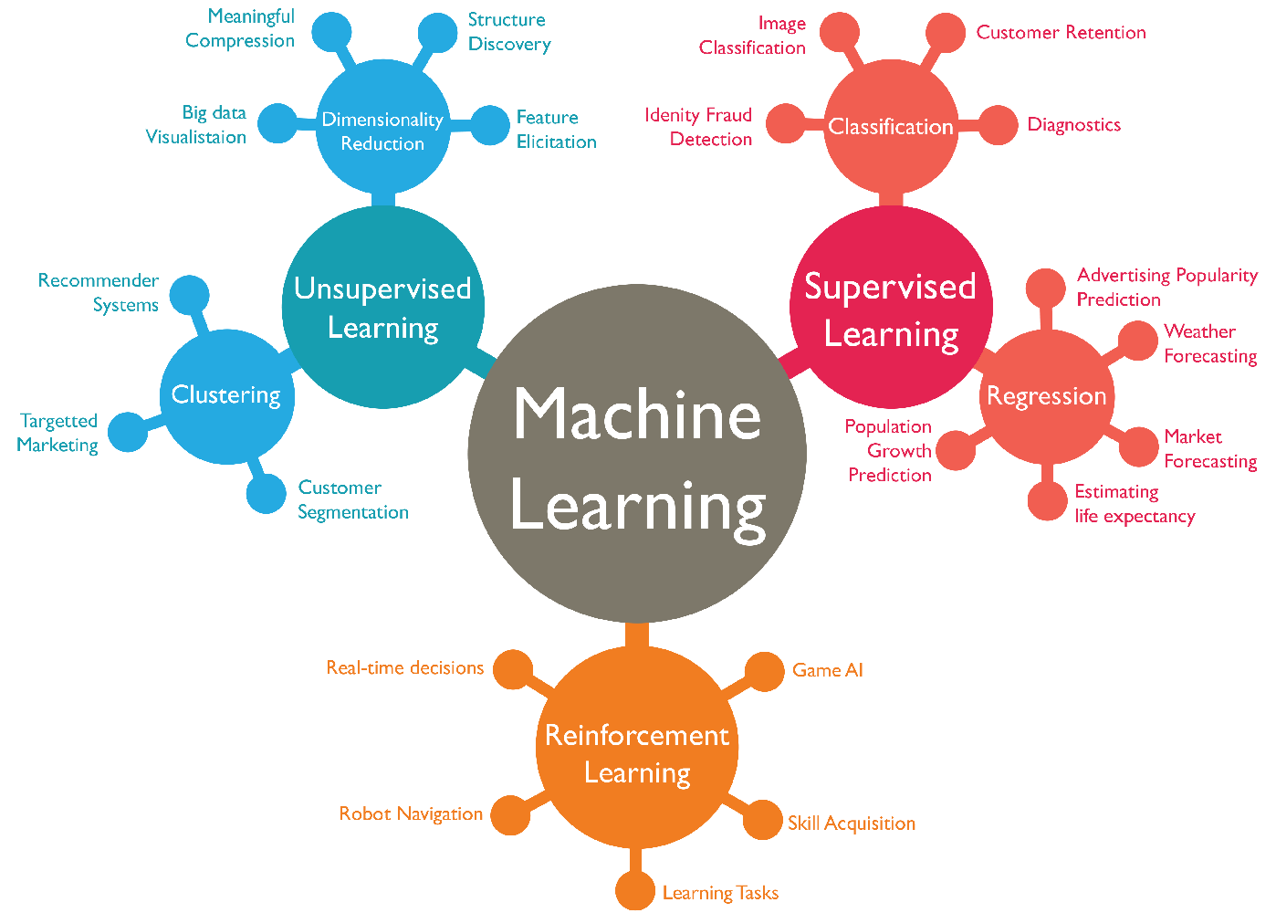
Reinforcement Learning
Supervised Learning
Unsupervised Learning
Machine Learning
Reinforcement Learning
Image source
8/7/2024
FIT5226-S2-2024
3/65

Slide 4
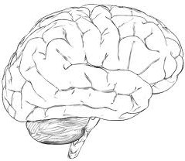
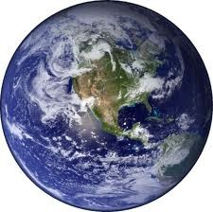
RL: Learning by Trial & Error
In each step the agent
performs an action
receives a reward
environment changes
environment is not directly visible to agent
agents learns an internal representation of the
environment based on
the reward (experience)
observation
action
O_{t}
A_{t}
reward
R_{t}
8/7/2024
FIT5226-S2-2024
4/65

Slide 5
Learning the Environment by Trial & Error
the environment is not known and needs to be learned
no supervisor knowledge
environment can only be learned through the reward
actions change the environment
from the agent perspective the environment is dynamic and stochastic
dynamics capture in a (discrete) “state” of the environment,
stochasticity captured in probabilistic state transitions.
In MAS, the (unknown) actions of others also change the environment.
we will initially focus on the single-agent perspective
ie. we are treating the others as a part of the (unknown) environment
8/7/2024
FIT5226-S2-2024
5/65

Slide 6
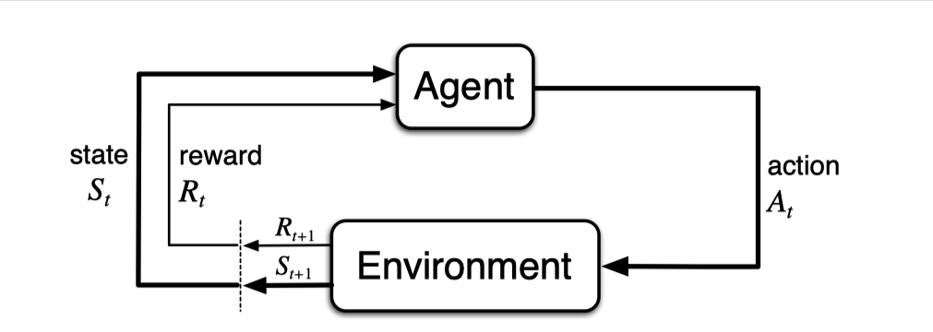
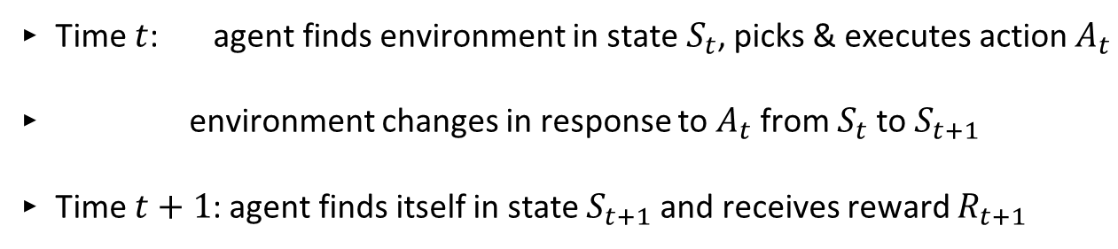
Action-Cycle
Time $t$: agent finds environment in state $S_{t}$, picks & executes action $A_{t}$
environment changes in response to $A_{t}$ from $S_{t}$ to $S_{t+1}$
Time $t+1$: agent finds itself in state $S_{t+1}$ and receives reward $R_{t+1}$
8/7/2024
FIT5226-S2-2024
6/65

Slide 7

Markov Property
We are talking about Markov systems.
Reminder: A system is markov if for all states
$P(S_{t+1}∣S_{t})=P(S_{t+1}∣S_{1},…,S_{t})$
The future is independent of the past given the present
i.e. history can be forgotten iff the current state is known
8/7/2024
FIT5226-S2-2024
7/65

Slide 8
Goal of the Agents
The goal of the agent is to
learn about the environment
while maximising the (cumulative) reward
Need to balance
exploration of the environment
exploiting the environment
8/7/2024
FIT5226-S2-2024
8/65

Slide 9
Exploration vs Exploitation
Restaurant Choice
Online Banner Advertisements
Oil Drilling
Game Playing
Exploitation: Perform best action based on current information to get good rewards (agent can get immediate rewards, but may be suboptimal)
Exploration: Explore previously unknown actions to gain information (may involve short-term scarifies), which may give better long-term rewards
8/7/2024
FIT5226-S2-2024
9/65
Notes:
Exploration: during exploration, the agent may select actions with lower immediate rewards, but it aims to gain information about the environment and potentially discover high rewarding actions in the long run.
Exploitation: This strategy involves the agent selecting actions that it believes will maximize immediate rewards based on the information it has gathered so far.

Slide 10
Components of Agents
An RL agent may include any or all of:
Policy: agent’s behaviour function
Value function: how good is each state and/or action
Model: agent’s representation of the environment
8/7/2024
FIT5226-S2-2024
10/65
Notes:
Policy tells me given a certain state what/how to take action.

Slide 11
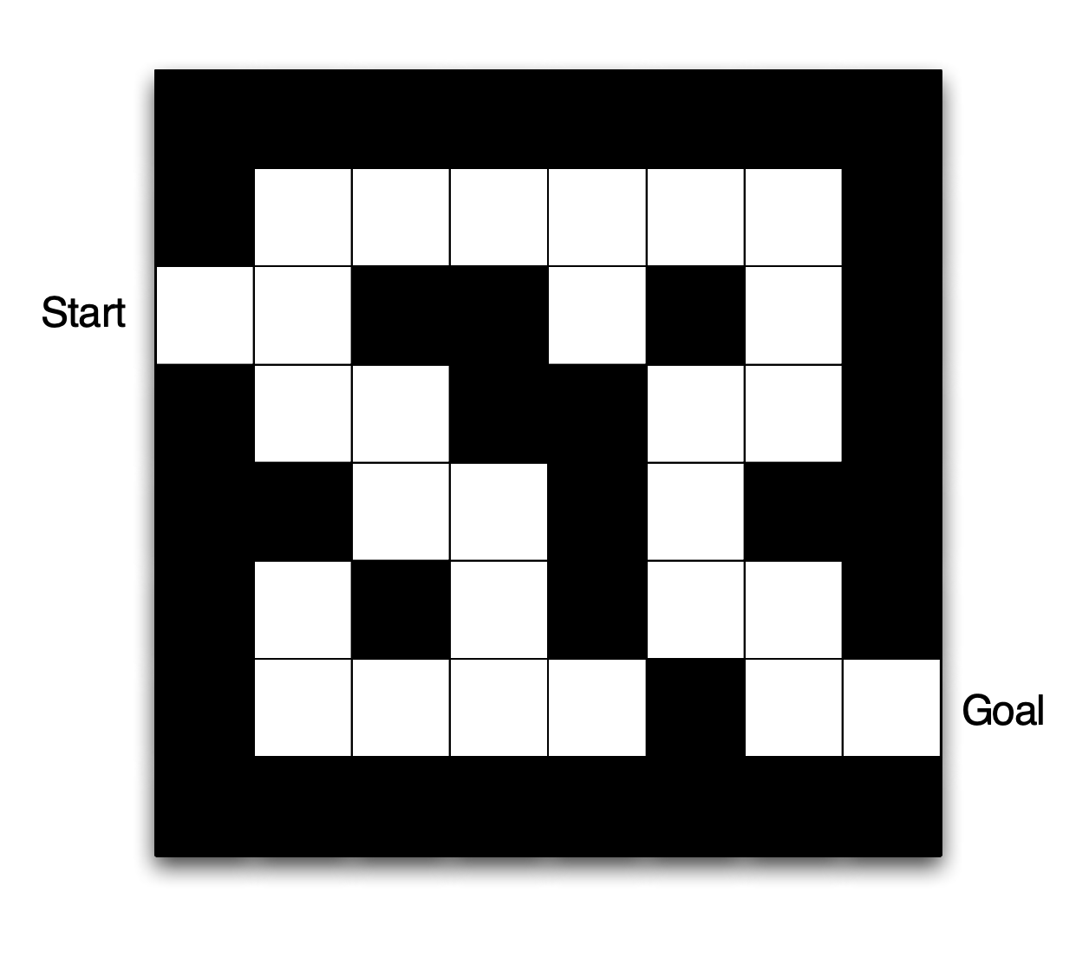
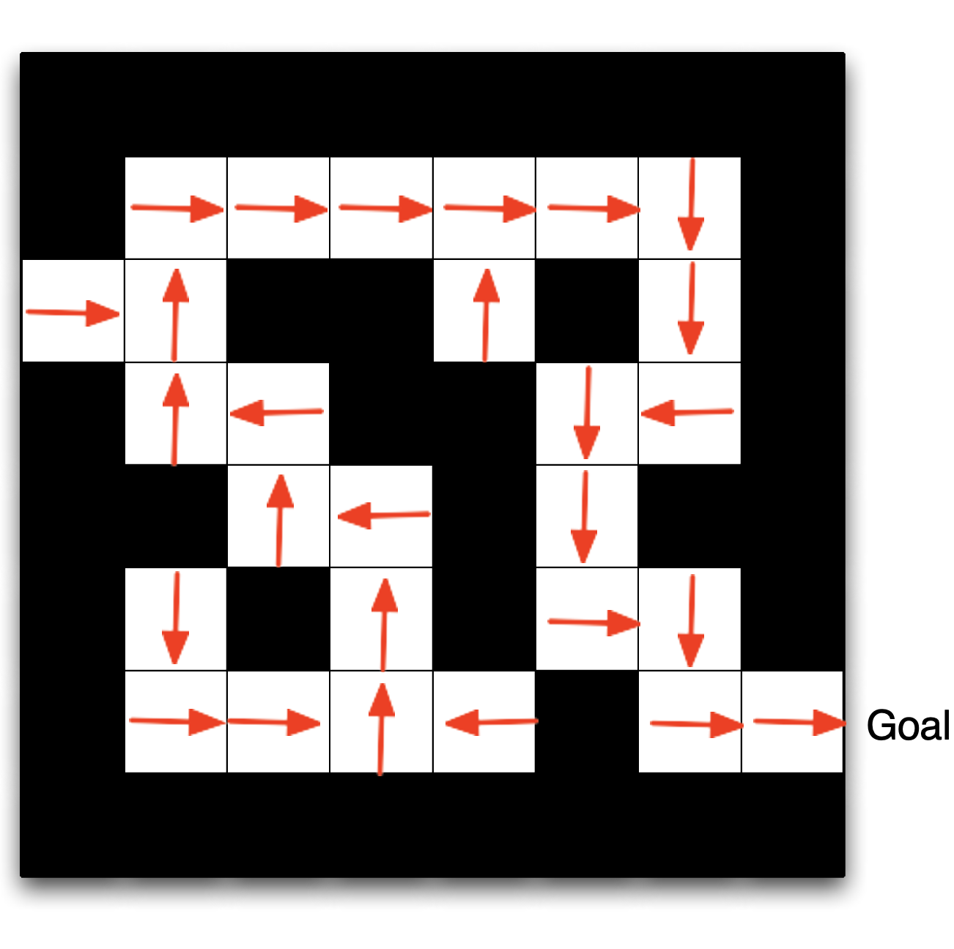
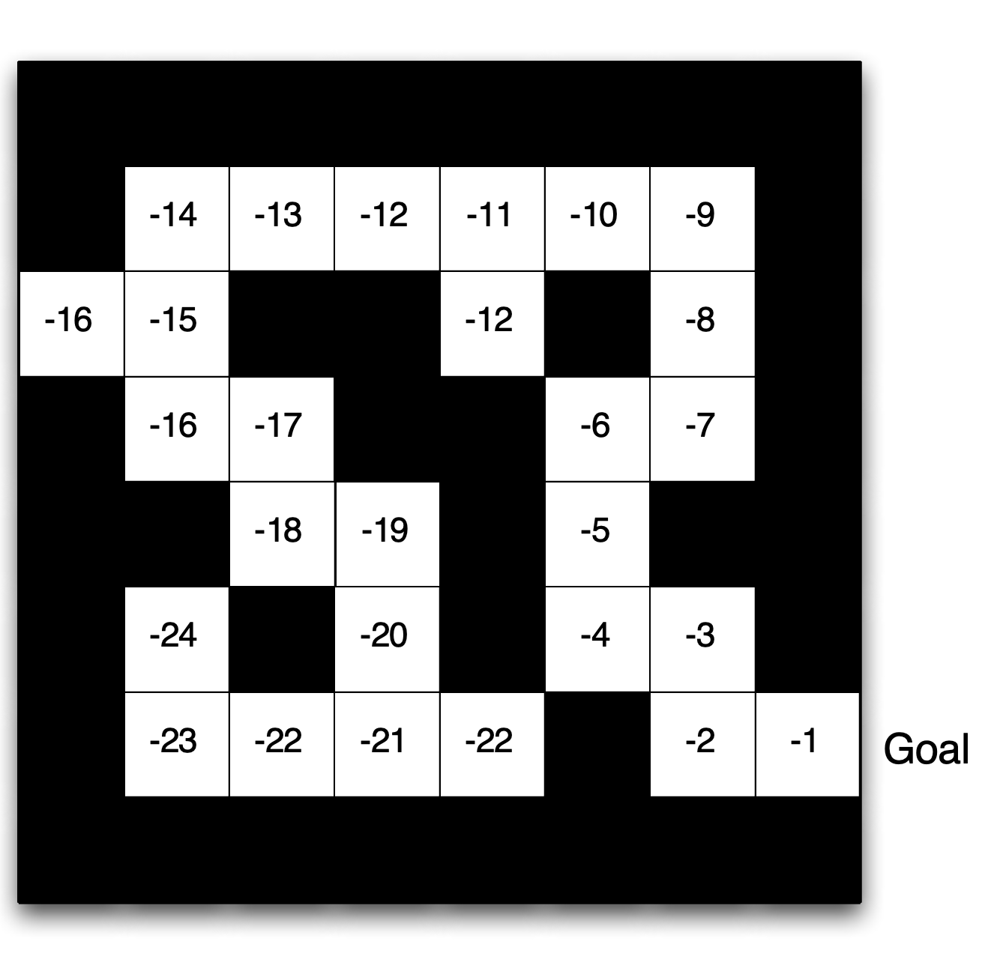
A First Example: Navigating a Maze
States: locations (grid cell)
Rewards: -1 per time step
Actions: up, down, left, right
Environment
Policy
Value Function
8/7/2024
FIT5226-S2-2024
11/65

Slide 12

Policy
A policy defines the agent’s behaviour It is a map from state to action, e.g.
Deterministic policy: $a=π(s)$
Stochastic policy: $π(a∣s)=P[Action=a∣state=s]$
8/7/2024
FIT5226-S2-2024
12/65

Slide 13

Value Function
The value function predicts the future reward in a state given a policy
$$v_{π}(s)=𝔼_{π}[R_{t+1}+γR_{t+2}+γ^{2}R_{t+3}+…γ^{∞}R_{t+∞}∣S_{t}=s]$$
8/7/2024
FIT5226-S2-2024
13/65
Notes:
Value function: is the cumulative rewards that I am expecting to get.
\gamma is a discount factor that depends on the actions that we will make in the future.

Slide 14

Model
A model (P, R) captures the environment
P predicts the next state $P_{s,s^{′}}^{a}=P[s_{t+1}=s^{′}∣s_{t}=s,a_{t}=a]$
R the next reward $R_{s}^{a}=𝔼[R_{t+1}∣s_{t}=s,a_{t}=a]$
8/7/2024
FIT5226-S2-2024
14/65
Notes:
If I am at state s, and I am taking action a, I will end up in state s’ with this probability.

Slide 15

RL Agent Types (Taxonomy)
Model-Free
Value Function
Actor Critic
Policy
Value-Based
Policy-Based
Model-Based
Model
8/7/2024
FIT5226-S2-2024
15/65
Notes:
Agent can be model-based or model-free. It even can contain only policy.

Slide 16
Markov Decision Process (MDP)
Markov decision processes are a formal description of an RL environment
Describes decision making in a fully observable environment, i.e. the state completely characterises the process
Special forms, extensions:
bandits: single-state MDPs
continuous MDPs (control)
partially observable environments (POMDP)
8/7/2024
FIT5226-S2-2024
16/65
Notes:
To describe the process of how an agent knows in which state it is, we are going to use a mathematical tool called Markov Decision Process.
partially observable environments: The agent does not get all the information all the time.
Bandits: slot machine game, vending soda machine.
Continuous MDPs: self-driving car (continuous decisions at each time steps – steering angle, acceleration)
Partially observable environment: robot in a multiple room maze. It only knows local information of current position.

Slide 17
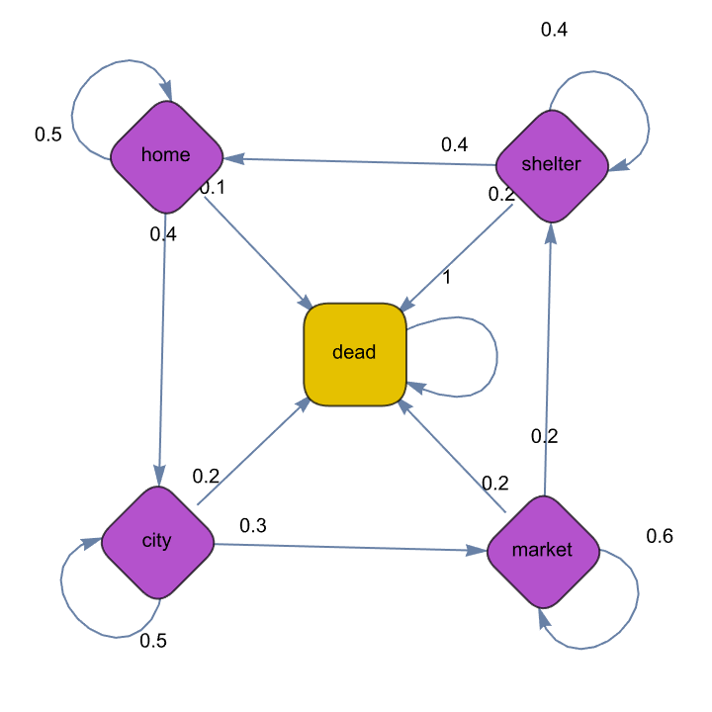
Example: The 7 lives of cats (MC)
8/7/2024
FIT5226-S2-2024
17/65
Notes:
We only look at single life here.
If we have a large population of cats, we many I am likely to find on average in the city, market, shelter, …
The cats are agents. What should I do to get the max accumulative reward?

Slide 18
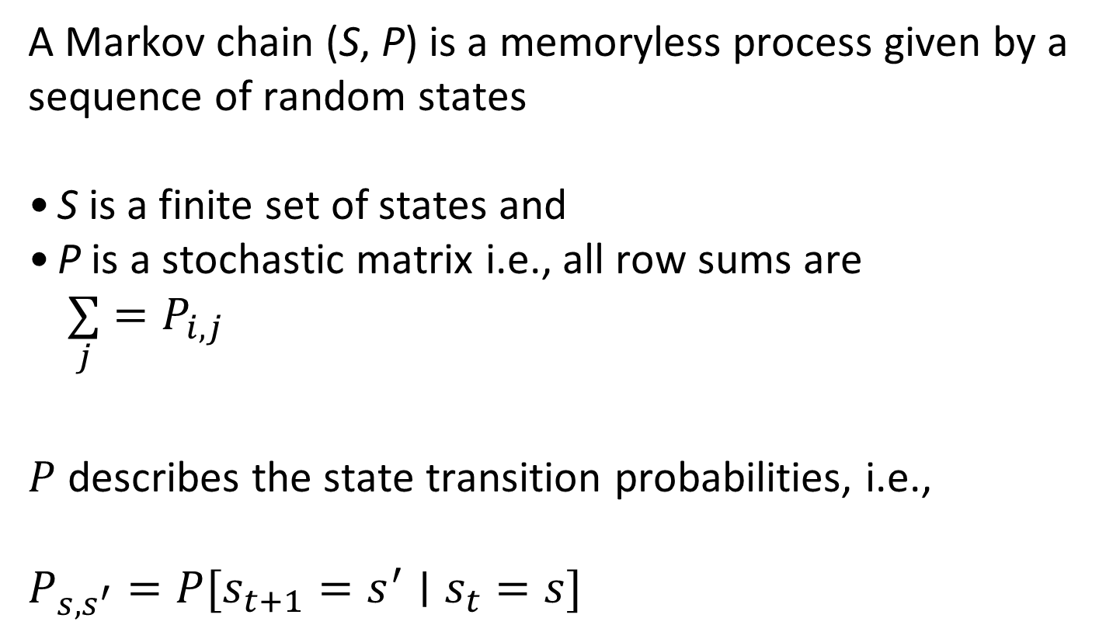
Reminder: Markov Chain
A Markov chain (S, P) is a memoryless process given by a sequence of random states
S is a finite set of states and
P is a stochastic matrix i.e., all row sums are $\underset{j}{∑}=P_{i,j}$
$P$ describes the state transition probabilities, i.e.,
$$P_{s,s^{′}}=P[s_{t+1}=s^{′}∣s_{t}=s]$$
8/7/2024
FIT5226-S2-2024
18/65
Notes:
Markov chains tell us how to move in an environment that we characterised by states with probabilistic transitions.

Slide 19
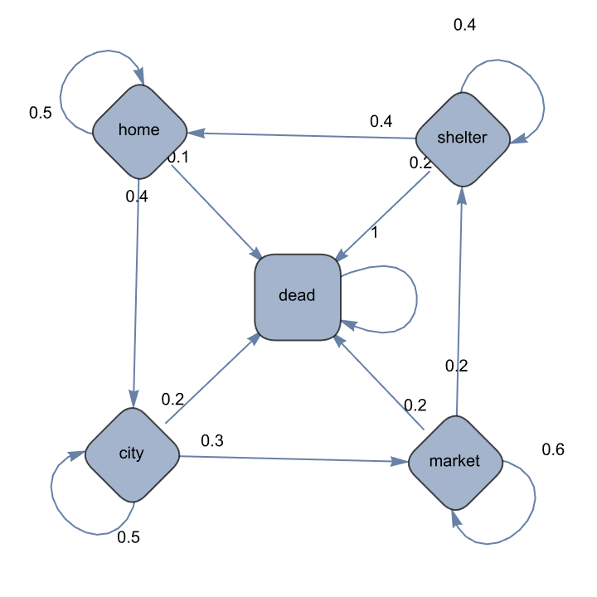
Example: The 7 lives of cats (MC)
Transition Matrix
 | h | s | c | m | d
h | 0.5 | 0 | 0.4 | 0 | 0.1
s | 0.4 | 0.4 | 0 | 0 | 0.2
c | 0 | 0 | 0.5 | 0.3 | 0.2
m | 0 | 0.2 | 0 | 0.6 | 0.2
d | 0 | 0 | 0 | 0 | 1
8/7/2024
FIT5226-S2-2024
19/65
Notes:
Dead is an absorbing state.

Slide 20
Example: The 7 lives of cats (MC)
Sample episodes for 7LoC Markov Chain starting from S1 = home
S1, S2, ..., ST
{home, home, home, home, city, market, market, market, market, dead, dead}
{home, dead, dead, dead, dead, dead, dead, dead, dead, dead, dead}
{home, home, city, market, shelter, shelter, shelter, shelter, shelter, shelter, home}
8/7/2024
FIT5226-S2-2024
20/65
Notes:
Dead is an absorbing state.
Episodes: Each episode consists of a sequence of time steps. For example, the agent’s interactions with the environment are divided into a distinct set of episodes. Each episode starts from an initial state and proceeds through a series of time steps, and transitions until a terminal state is reached.
No infinity state sequence

Slide 21

Markov Reward Process (MRP)
A Markov reward process $(S,P,R,γ)$ is a Markov chain $(S,P)$ with associated rewards
$$R(s)=𝔼[R_{t+1}∣s_{t}=s]$$
and discount factor $0≤γ∈ℝ≤1$
P describes the state transition probabilities, ie
$$P_{s,s^{′}}=P[s_{t+1}=s^{′}∣s_{t}=s]$$
8/7/2024
FIT5226-S2-2024
21/65
Notes:
Reward discounts make future rewards less important.

Slide 22
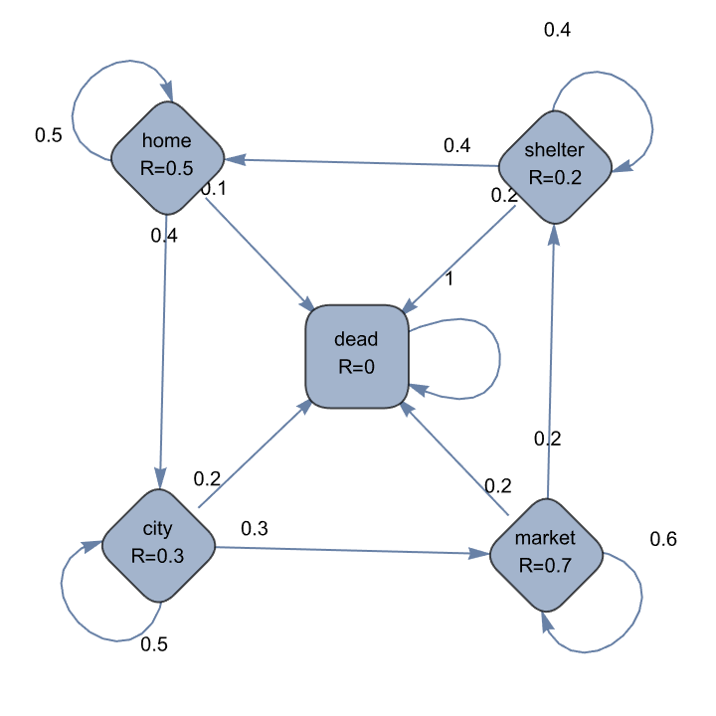
Example: The 7 lives of cats (MRP)
8/7/2024
FIT5226-S2-2024
22/65
Notes:
If I am at home I will get a reward of 0.5, if in shelter a lower reward of 0.2, if in city I get better than shelter 0.3, but in market I get really high reward of 0.7.

Slide 23

Return – don’t only look at the instantaneous reward
The return $G_{t}$ is the discounted sum of all future rewards
$$G_{t}=\overset{T}{\underset{i=0}{∑}}γ^{i}R(s_{t+i+1})$$
immediate reward more important than future reward
$γ=0$ values only immediate reward (“myopic")
$γ=1$ does not discount
8/7/2024
FIT5226-S2-2024
23/65
Notes:
How much reward do I actually gather until then T, what is the expectation?
If \gamma is 0, it means I am not caring about future rewards. I am concerned about the current state reward only.
Myopic: focusses on the immediate rewards without considering long-term consequences.

Slide 24
Discount factors
ensure that we can handle infinite episodes mathematically
capture some notion of the uncertainty of the future
are often practically justified (e.g. financial investment)
reflect psychology: children (and people generally) prefer immediate reward!
8/7/2024
FIT5226-S2-2024
24/65

Slide 25

Value
The value of a state is the expected return from this state
$$v(s)=𝔼[G_{t}|S_{t}=s]$$
Reminder: the value function of an agent predicts the future reward in a state given a policy (but we have no policy yet, i.e., no influence on the environment)
$$v_{π}(s)=𝔼_{π}[R_{t+1}+γR_{t+2}+γ^{2}R_{t+3}+…γ^{∞}R_{t+∞}∣S_{t}=s]$$
8/7/2024
FIT5226-S2-2024
25/65
Notes:
The value is simply accumulating all rewards, what is the expectation of that, provided I am in a particular policy? The policy is telling me which action to take, and from this action, I know which state I will end up with certain probabilities.
In the cat example, for MRP, we don’t have to worry about that, because we don’t have actions. We have a Markov chain with a transition matrix, so we know the next state.

Slide 26

Example: The 7 lives of cats (state value)
$$γ=0$$
(“myopic”)
0.5
0.2
0.00
0.3
0.7
8/7/2024
FIT5226-S2-2024
26/65

Slide 27

Example: The 7 lives of cats (state value)
1.16
0.72
$$γ=0.7$$
0.00
0.91
1.38
8/7/2024
FIT5226-S2-2024
27/65
Notes:
Shelter = 0.5 + (0.7 * 0.3) =

Slide 28

Example: The 7 lives of cats (state value)
1.93
1.39
$$γ=0.9$$
0.00
1.56
2.07
8/7/2024
FIT5226-S2-2024
28/65

Slide 29

Markov Decision Process (MDP)
A Markov decision process $(S,A,P,R,γ)$ is a Markov reward process $(S,P,R,γ)$ with associated finite set of actions A. It consists of
a finite set of states S
a finite set of actions A
a reward function
$R_{s}^{a}=𝔼[R_{t+1}∣S_{t}=s,A_{t}=a]$
a discount factor $0≤γ∈ℝ≤1$
a stochastic matrix P describing state transition
$P_{s,s^{′}}^{a}=P[S_{t+1}∣S_{t}=s,A_{t}=a]$
8/7/2024
FIT5226-S2-2024
29/65
Notes:
MDP vs MRP differs only by adding actions A to MDP.

Slide 30
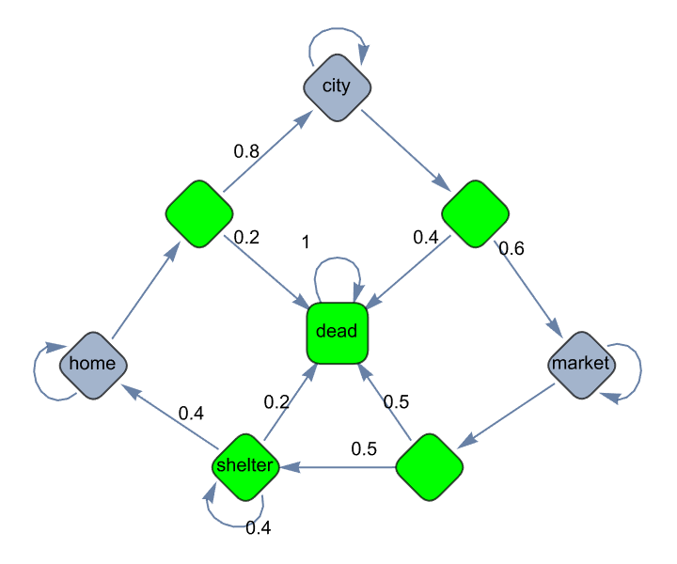
Example: The 7 lives of cats (MDP)
8/7/2024
FIT5226-S2-2024
30/65
Notes:
Including two actions (stay or run). The green diamond shapes represent some intermediate node (no agency) so that we can model the process. The other nodes are named decision nodes.
If in shelter, I have no agency, because adoption does not depend on me. You can try to be cute, when people come to see you, but this is not included in the model.

Slide 31
Take home lessons
Reinforcement learning models how (independent) agents learn about an unknown environment.
Agents learn by exploring the consequences of their actions (observed through rewards received).
Actions (can) modify the environment.
A policy describes how an agent behaves.
A value function describes how desirable an agent judges a particular environment state top be.
MRP = MC + rewards
MDP = MRP with actions determining transition probabilities
MDPs are the most fundamental modelling framework for RL
8/7/2024
FIT5226-S2-2024
31/65

Slide 32
Acknowledgments
This material includes content adapted from instructional resources made available by David Silver as part of his Reinforcement Learning course at UCL under CC-BY-NC 4.0.
Refer to https://www.davidsilver.uk/teaching/ for full details
8/7/2024
FIT5226-S2-2024
32/65

Slide 33
School of Information Technology
https://www.monash.edu.my/
FIT5226
Multi-agent System & Collective Behaviour
Week 3-2: Bellman Equation, Policy and Value Iteration
FIT3155-S2-2024
Prepared by: Bernd Meyer. Edited by: Fuad Noman
www.monash.edu.au

Slide 34
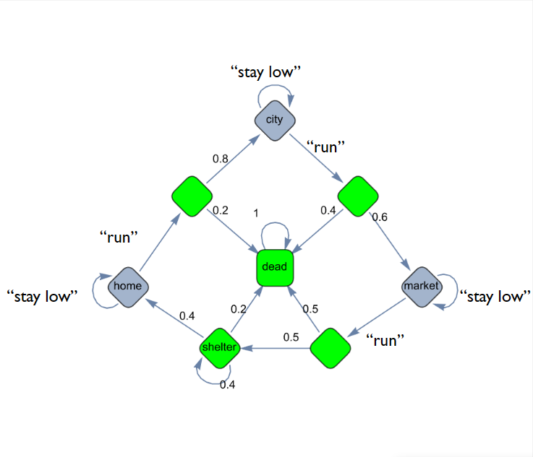
Example: The 7 lives of cats (MDP)
8/7/2024
FIT5226-S2-2024
34/65

Slide 35

Reminder: Policy
A policy defines the agent’s behavior
It is a map from state to action, e.g.,
Deterministic policy: $a=π\left(s\right)$
Stochastic policy: $π\left(a | s\right)=P\left[Action=a | state=s\right]$
8/7/2024
FIT5226-S2-2024
35/65

Slide 36
Reminder: Model
A model (P, R) captures the environment
P predicts the next state $P_{s,s^{′}}^{a}=P[s_{t+1}=s^{′}∣s_{t}=s,a_{t}=a]$
R the next reward $R_{s}^{a}=𝔼[R_{t+1}∣s_{t}=s,a_{t}=a]$
8/7/2024
FIT5226-S2-2024
36/65
Notes:
If I am at state s, and I am taking action a, I will end up in state s’ with this probability.

Slide 37

From MDP back to MRP
For any MDP , $M=\left(S, A, P, R, γ\right)$
A policy $π$ and a start state $S_{1}$ together include
A Markov Chain $\left(S, P^{π}\right)$
An associated state sequence $S_{1}, S_{2}, …, S_{n}$
Reward $R$ and discount factor $γ$ then include
A Markov Reward Process $\left(S, P^{π}, {R }^{π}, γ\right)$
A state-reward sequence $S_{1}, R_{2}, S_{2}, …, R_{n}, S_{n}$ with $P_{s, s^{′}}^{π}=\sum_{a}{π\left(a, s\right)}P_{s, s^{′}}^{a} and R_{s}^{π}=\sum_{a}{π\left(a, s\right)R_{s}^{a}}$
8/7/2024
FIT5226-S2-2024
37/65

Slide 38

Value Functions
The state-value function for an MDP $M=\left(S, A, P, R, γ\right)$, and policy $π$ gives the expected return from a state following that policy,
$v_{π}\left(s\right)=𝔼_{π}\left[G_{t} | S_{t}=s\right]$
with state sequence $S_{1}, S_{2}, …, S_{n}$
The action-state-value function gives the expected return from a state taking action $a$ and then following that policy
$q_{π}\left(s, a\right)=𝔼_{π}\left[G_{t} | S_{t}=s, A_{t}=a\right]$
8/7/2024
FIT5226-S2-2024
38/65
Notes:
Two types of “value function”, so far we’ve talked about a “state value function”.
The state value function represents the expected cumulative reward an agent can achieve starting from a particular state s and following a certain policy.
The state action value function represents the expected cumulative reward an agent can achieve by taking a specific action a in a particular state s and then following a certain policy.

Slide 39
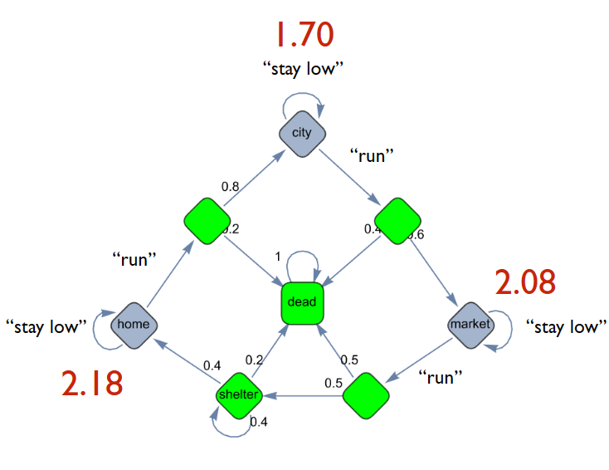
Example: The 7 lives of cats (state-value)
$$v_{π}\left(s\right) for π\left(a,s\right)=0.5, γ=0.95$$
8/7/2024
FIT5226-S2-2024
39/65
Notes:
We have a policy, which says “If I am in a particular state s, I am taking either action (stay/run) with a probability of 0.5”
If I have that policy, it induces Markov chain (transitions) and MRP, and I can calculate my state values. The state values are 1.70 for being in city, 2.08 in market, and 2.18 in home.
How to compute these state values? Next …

Slide 40
Reminder: Value
The value of a state is the expected return from this state
$$v(s)=𝔼[G_{t}|S_{t}=s]$$
Reminder: the value function of an agent predicts the future reward in a state given a policy (but we have no policy yet, i.e., no influence on the environment)
$$v_{π}(s)=𝔼_{π}[R_{t+1}+γR_{t+2}+γ^{2}R_{t+3}+…γ^{∞}R_{t+∞}∣S_{t}=s]$$
8/7/2024
FIT5226-S2-2024
40/65
Notes:
The value is simply accumulating all rewards, what is the expectation of that, provided I am in a particular policy? The policy is telling me which action to take, and from this action, I know which state I will end up with certain probabilities.
In the cat example, for MRP, we don’t have to worry about that, because we don’t have actions. We have a Markov chain with a transition matrix, so we know the next state.

Slide 41

Bellman Equation (Expectation)
The state value function can recursively be decomposed into
immediate reward and
discounted future reward
$$v_{π}\left(s\right)=𝔼\left[R_{t+1}+γR_{t+2}+γ^{2}R_{t+3}+…+γ^{∞}R_{t+∞}| S_{t}=s\right]$$
$$v_{π}\left(s\right)=𝔼\left[R_{t+1}+γv_{π}\left(s_{t+1}\right) | S_{t}=s\right]$$
8/7/2024
FIT5226-S2-2024
41/65
Notes:
Bellman equation is used to solve MDPs by providing a recursive relationship between the state value (or state-action value) and the values of its successor state.
We use the Bellman equation for Policy Evaluation and Policy improvement. In other words, how do we find the right policy, and how do we maximize it?

Slide 42

Bellman Equation (Expectation)
Both value functions can recursively be decomposed in the same way, into
immediate reward and
discounted future reward
$$v_{π}\left(s\right)=𝔼\left[R_{t+1}+γv_{π}\left(S_{t+1}\right) | S_{t}=s\right]$$
$$q_{π}\left(s, a\right)=𝔼\left[R_{t+1}+γq_{π}\left(s_{t+1}, a_{t+1}\right) | S_{t}=s, A_{t}=a\right]$$
State Value Function
Action-Value Function (state-action)
8/7/2024
FIT5226-S2-2024
42/65
Notes:
Bellman equation is used to solve MDPs by providing a recursive relationship between the state value (or state-action value) and the values of its successor state.
We use the Bellman equation for Policy Evaluation and Policy improvement. In other words, how do we find the right policy, and how do we maximize it?

Slide 43

Direct Solution for Bellman Equation
The Bellman equation can be compactly written via the induced MRP in matrix form as
$$v_{π}=R^{π}+γP^{π}v_{π}$$
With closed-form solution
$$v_{π}={\left(1−γ P^{π}\right)}^{−1}R^{π}$$
8/7/2024
FIT5226-S2-2024
43/65
Notes:
Our current problem is that we have given policy we're not arguing with that policy all that we're trying to figure out is if I follow that policy what's the state value.
This might be complicated plus these matrix inversions are not computationally cheap. The computational complexity is O(n^3) for n states.

Slide 44

Iterative Policy Evaluation
Problem: evaluate a given policy $π$
Solution: iterative application of Bellman expectation
$$v_{1}→v_{2}→…→v_{n}=v_{π}$$
Update $v_{k+1}\left(s\right)$ from $v_{k}\left(s^{′}\right)$ where $s^{′}$ is a successor state of $s$ according to Bellman Expectation equation
note: subscript $k$ is the iteration of the evaluation, not the step number
Evaluate for all states, at each iteration
Convergence to $v_{π}$ can be proven
8/7/2024
FIT5226-S2-2024
44/65
Notes:
I we can’t apply the closed form solution, we use this iterative approach.
Init $v_{k}\left(s\right) ∀ s∈S$
For Iter = 1 to k:
For $s$ = $s_{n}$ to $s_{1}$:
Update $v_{k+1}\left(s\right)=E\left[R_{t+1}+γv_{k}\left(s^{′}\right) | S_{t}=s\right]$

Slide 45
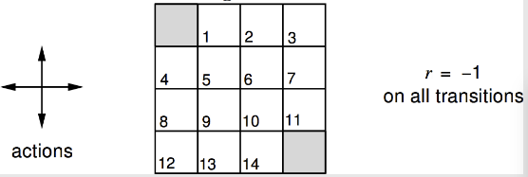

Evaluating a Policy: Computing the Value Function
Undiscounted episodic MDP $(γ=1)$
Nonterminal states $1, …, 14$
One terminal state (shown twice as shaded squares)
Actions leading out of the grid leave state unchanged
Reward is $−1$until the terminal state is reached
Agent follows uniform random policy $π\left(s, _\right)=π\left(n, _\right)=π\left(w, _\right)=π\left(e, _\right)=0.25$
8/7/2024
FIT5226-S2-2024
45/65

Slide 46
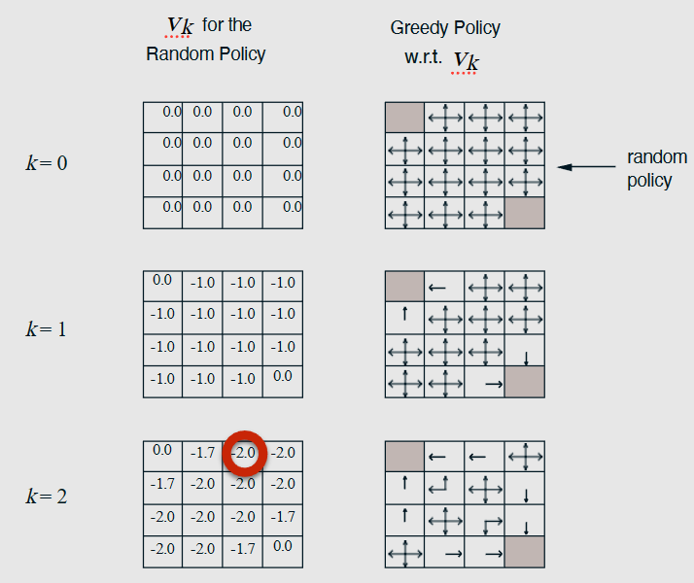

Iterative Policy Evaluation for GridWorld
We pick a new policy according to greedy state values
$$v_{π}^{k+1}​=R_{π}+γP^{π}v_{π}^{k}$$
8/7/2024
FIT5226-S2-2024
46/65
Notes:
For example computing $v^{\left(2\right)}\left(1,2\right)$:
$v^{\left(2\right)}\left(1,2\right)=\frac{1}{4}\left[\left(R_{left}+γv^{\left(1\right)}\left(1,1\right)\right)+\left(R_{right}+γv^{\left(1\right)}\left(1,3\right)\right)+\left(R_{up}+γv^{\left(1\right)}\left(0,2\right)\right)+\left(R_{down}+γv^{\left(1\right)}\left(2,2\right)\right)\right]$
Assuming $γ=1$, the $\frac{1}{4}$ is the equal probability of moving to any direction (0.25)
$v^{\left(2\right)}\left(1,2\right)=\frac{1}{4}\left[\left(−1+(0)\right)+\left(−1+(−1)\right)+\left(−1+\left(−1\right)\right)+\left(−1+\left(−1\right)\right)\right]$
$v^{\left(2\right)}\left(1,2\right)=\frac{1}{4}\left[−1−2−2−2\right]=1.75$

Slide 47
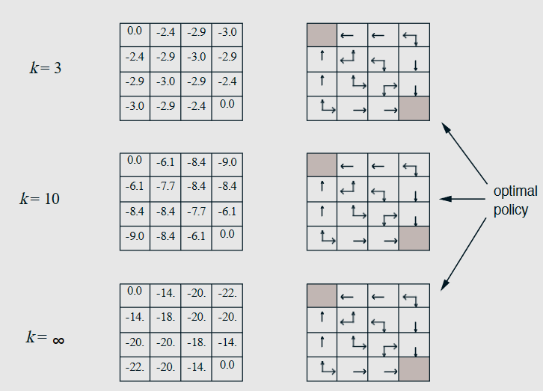
Iterative Policy Evaluation for GridWorld
8/7/2024
FIT5226-S2-2024
47/65

Slide 48

Optimal Value Function
To “solve” an MDP we must find the optimal policy.
This amounts to optimising the value function over all possible policies
$$v_{⋆}\left(s\right)=\max_{π}{v_{π}}\left(s\right)$$
with
$$v_{⋆}\left(s\right)=\max_{a}{q_{⋆}}\left(s, a\right)$$
$$q_{⋆}\left(s,a\right)=\max_{π}{q}\left(s, a\right)$$
8/7/2024
FIT5226-S2-2024
48/65
Notes:
First Eqn: I want to know what is $v_{∗}$ that maximizes the state values over all possible policies.
Second Eqn: the optimal value for a particular state that maximizes the state action value over all possible actions.
Third Eqn: the best state action $q_{∗}$ is the maximum of all policies of $q\left(s,a\right)$.

Slide 49

Computing the Optimal Policy
The optimal policy can be derived from $q_{⋆}$ by acting greedily (We pick a new policy according to greedy action values)
$$π_{⋆}\left(a,s\right)=\left\{\begin{aligned}1 if a=\underset{a∈A}{argmax}{q_{⋆}\left(s,a\right)} \\ 0 otherwise \end{aligned}\right.$$
If we know $q_{⋆}$ we know the optimal policy directly
There is always a deterministic optimal policy!
8/7/2024
FIT5226-S2-2024
49/65
Notes:
The best policy is always related to state action values as greedy thing (pick the best one).
The deterministic optimal policy can tell you exactly what action you are supposed to take at any state, the greedy choice over all the state action values. There is no stochastic decisions here, e.g., at prob 0.5 I should be doing this action, and with 0.5 I should do the other action.

Slide 50
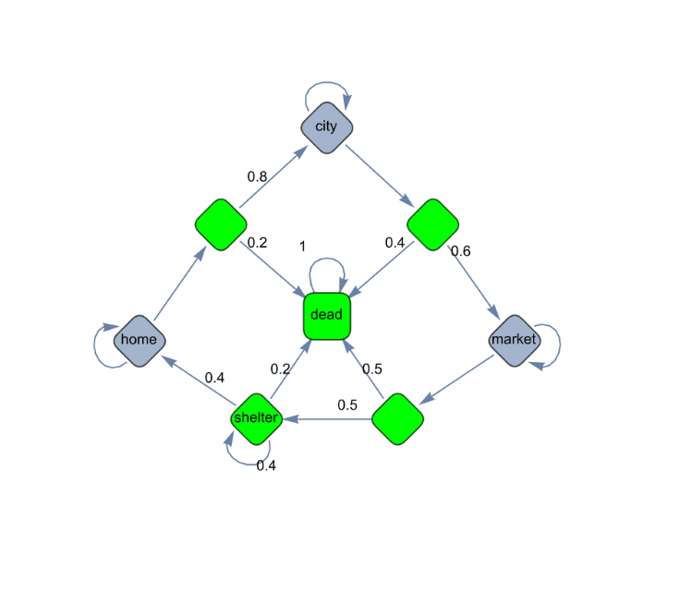








Optimal Policy for Cats
7.97
“stay low”
$$q_{⋆}=7.97$$
$$γ=0.95$$
“Stay at home!”
“run”
$$q_{⋆}=7.88$$
“run”
$$q_{⋆}=6.06$$
13.99
“stay low”
$$q_{⋆}=7.99$$
“stay low”
$$q_{⋆}=13.99$$
7.99
“run”
$$q_{⋆}=2.48$$
$$v_{⋆}$$
8/7/2024
FIT5226-S2-2024
50/65

Slide 51






Optimal Policy for Cats
10.63
“stay low”
$$q_{⋆}=10.41$$
$$γ=0.95$$
“run”
$$q_{⋆}=10.63$$
“Run!”
0.2
0.8
“run”
$$q_{⋆}=8.08$$
13.99
“stay low”
$$q_{⋆}=5.28$$
“stay low”
$$q_{⋆}=13.99$$
8.08
“run”
$$q_{⋆}=2.51$$
$$v_{⋆}$$
8/8/2024
FIT5226-S2-2024
51/65
Notes:
We make it a little bit less likely to die when “run”, by reducing the dead probability from 0.4 to 0.2.

Slide 52

Reminder: Bellman Equation (Expectation)
Both value functions (for expectation) can recursively be decomposed in the same way, into
immediate reward and
discounted future reward
$$v_{π}\left(s\right)=𝔼\left[R_{t+1}+γv_{π}\left(S_{t+1}\right) | S_{t}=s\right]$$
$$q_{π}\left(s, a\right)=𝔼\left[R_{t+1}+γq_{π}\left(s_{t+1}, a_{t+1}\right) | S_{t}=s, A_{t}=a\right]$$
8/7/2024
FIT5226-S2-2024
52/65

Slide 53




Bellman Optimality Equation for $q_{⋆}$
The Bellman optimality equation for $q_{⋆}$ can be recursively decomposed just like the Bellman expectation equation
$$q_{⋆}\left(s, a\right)=R_{s}^{a}+γ\sum_{s^{′}}{P_{s,s^{′}}^{a}\max_{a^{′}}{q_{⋆}\left(s^{′},a^{′}\right)}}$$
Expected immediate reward in state $s$ for action $a$
Best expected future reward in state $s$ for action $a$
8/7/2024
FIT5226-S2-2024
53/65
Notes:
Instead of taking the average of actions, we take the max

Slide 54


Bellman Optimality Equation for $v_{⋆}$
Likewise, the Bellman optimality equation for $v_{⋆}$ can be recursively decomposed in the same way
$$v_{⋆}\left(s\right)=\max_{a}\left(R_{s}^{a}+γ\sum_{s^{′}}{P_{s,s^{′}}^{a}v_{⋆}\left(s^{′}\right)}\right)$$
8/7/2024
FIT5226-S2-2024
54/65

Slide 55
Solving the Bellman Optimality Equation
The Bellman Optimality Equation
is non-linear
does not admit a closed form solution in general
needs to be solved iteratively using
Policy Iteration
Value Iteration
SARSA
Q-Learning…
8/7/2024
FIT5226-S2-2024
55/65
Notes:
State–action–reward–state–action (SARSA)

Slide 56

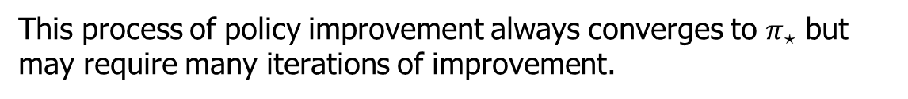
Policy Iteration
Given a policy $π$
Evaluate the policy $π$(as shown before) $v_{π}\left(s\right)=𝔼\left[R_{t+1}+γR_{t+2}+γ^{2}R_{t+3} | S_{t}=s\right]$
Improve the policy by acting greedily with respect to $v_{π}$ $π^{t}=greedy\left(v_{π}\right)$
repeat
This process of policy improvement always converges to $π_{⋆}$ but may require many iterations of improvement.
8/7/2024
FIT5226-S2-2024
56/65
Notes:
Policy Iteration
What It Does: Policy Iteration alternates between policy evaluation (computing the value function for a given policy) and policy improvement (updating the policy based on the value function). This process repeats until the policy converges to the optimal policy.
Algorithm:
Initialize a policy $π(s)$arbitrarily.
Policy Evaluation: Compute the value function $V^{π}(s)$ for the current policy by solving: $V^{π}\left(s\right)= {\sum_{\left\{s^{′}, r\right\}}{P\left(s^{′}, r | s,π\left(s\right)\right)\left[ r +γ V^{π}\left(s^{′}\right)\right]}}_{ }$(This step may require iterative methods if the state space is large.)
Policy Improvement: Update the policy: $π^{′}(s) = argmax_{a} \sum_{s′, r}{P\left(s^{′}, r | s,a\right)\left[ r +γ V^{π}\left(s^{′}\right)\right]}$
Convergence: Repeat the process until the policy stabilizes (i.e., policy no longer changes).
Characteristics:
It explicitly maintains and updates a policy at each iteration.
It tends to converge faster in terms of iterations compared to value iteration, especially in larger MDPs.
It often requires more computation per iteration because of the policy evaluation step.

Slide 57

Policy Iteration
Does the policy evaluation need to fully converge to $v_{π}$?
Could we stop earlier? e.g. fixed number of iterations
If fixed number of iterations, can we stop after the first one already $\left(k=1\right)$?
We can! This method is known as value iteration
8/7/2024
FIT5226-S2-2024
57/65

Slide 58
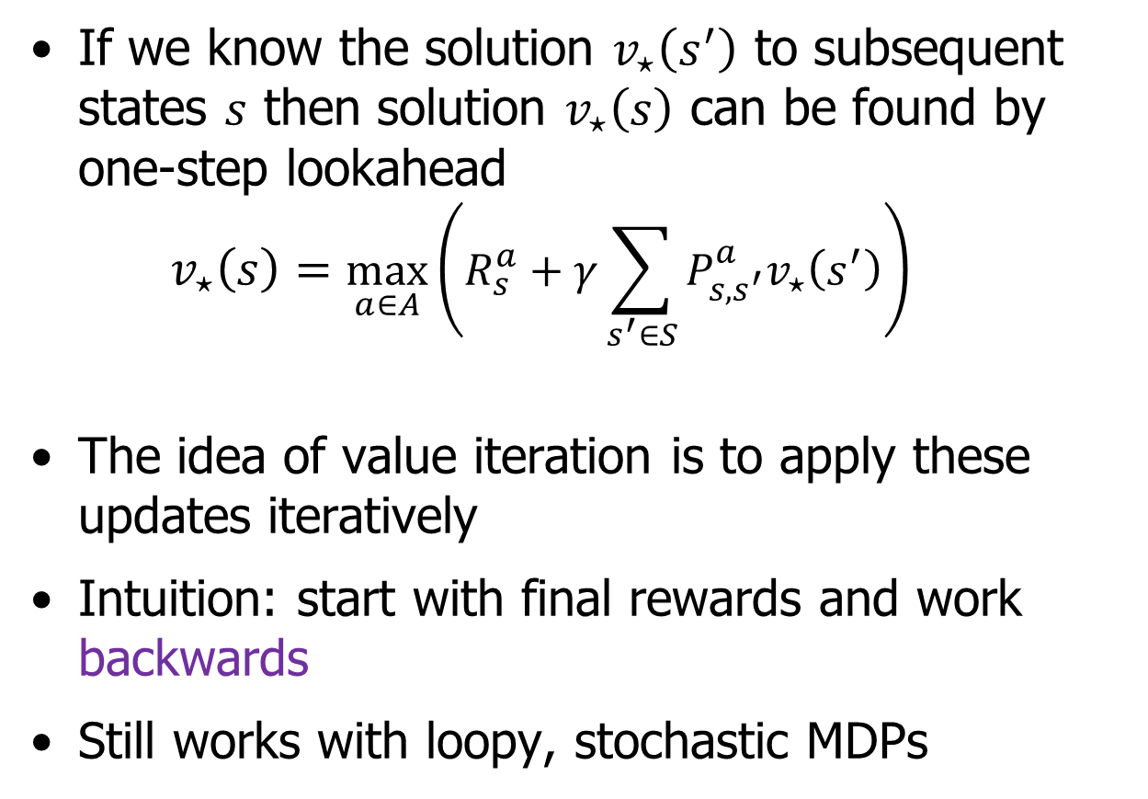
Deterministic Value Iteration
If we know the solution $v_{⋆}\left(s^{′}\right)$ to subsequent states $s$ then solution $v_{⋆}\left(s\right)$ can be found by one-step lookahead $v_{⋆}\left(s\right)=\max_{a∈A}\left(R_{s}^{a}+γ\sum_{s^{′}∈S}{P_{s,s^{′}}^{a}v_{⋆}\left(s^{′}\right)}\right)$
The idea of value iteration is to apply these updates iteratively
Intuition: start with final rewards and work backwards
Still works with loopy, stochastic MDPs
8/7/2024
FIT5226-S2-2024
58/65

Slide 59

Value Iteration
Problem: find optimal value function $v_{⋆}$
Solution: iterative application of Bellman optimality equation $v_{1}→v_{2}→…→v_{n}=v_{⋆}$
Update $v_{k+1}\left(s\right)$ from $v_{k}\left(s^{′}\right)$ where $s^{′}$ is a successor state of $s$
At each iteration, evaluate for all states
Convergence to $v_{⋆}$ can be proven
There is no explicit policy! (greedy policy over $v_{⋆}$)
8/7/2024
FIT5226-S2-2024
59/65
Notes:
Value Iteration
What It Does: Value Iteration combines the processes of policy evaluation and policy improvement into a single step. It iteratively updates the value function until it converges, and then derives the optimal policy from the final value function.
Algorithm:
Initialize the value function $v(s)$arbitrarily (usually to 0 for all states).
Iterate: $v(s)←\max_{a}{\sum_{s^{′}}{P\left(s^{′} | s,a\right)\left[R\left(s,a,s^{′}\right)+γ v\left(s^{′}\right)\right]}}$
Convergence: Repeat until $v(s)$converges to a stable value function.
Derive Policy: The optimal policy is then given by choosing actions that maximize the value: $π^{∗}\left(s\right)= argmax_{a}\sum_{s^{′}}{P(s′|s,a) [R(s,a,s′) +γ v(s′)] }$
Characteristics:
It directly computes the optimal value function.
The optimal policy is derived from this value function after convergence.
It is generally faster for small or well-structured MDPs.

Slide 60









Example: Shortest Path
$$V_{1}$$
$$V_{2}$$
-1
-1
-1
-1
-1
-2
-2
-2
-2
-2
0
-1
-1
-1
-1
0
-2
-2
-2
-2
-1
-1
-1
-1
-1
-1
-2
-2
-2
-2
$$V_{3}$$
-3
$$V_{4}$$
-4
$$Problem$$
-3
-3
-3
-3
-4
-4
-4
-4
0
-3
-3
-3
-3
0
-4
-4
-4
-4
-1
-2
-3
-3
-3
-1
-2
-3
-4
-4
g
$$V_{5}$$
$$V_{6}$$
-5
-5
-5
-5
-5
-6
-6
-5
-6
-6
0
-5
-4
-5
-5
0
-5
-4
-5
-6
-4
-1
-2
-3
-5
-5
-1
-2
-3
-6
-6
$$V_{7}$$
-7
-6
-5
-6
-7
$$V_{8}$$
-7
-6
-5
-6
-7
0
-5
-4
-5
-6
0
-5
-4
-5
-6
-1
-2
-3
-7
-7
-1
-2
-3
-8
-7
8/7/2024
FIT5226-S2-2024
60/65
Notes:
In $v_{5}$, how to compute $v(2, 3)$?
Right: moves to (2,4) = -5
Left: moves to (2,2) = -5
Up: moves to (1,3) = -5
Down: moves to (3,3) = -3
Assuming $γ=1$, the updated $v\left(2, 3\right)=max\left\{\left(−1+γ(−5)\right),\left(−1+γ(−5)\right),\left(−1+γ(−5)\right),\left(−1+γ(−3)\right)\right\}=−4$

Slide 61
Policy versus Value Iteration
Policy Iteration | Value Iteration
Starts with a random policy Algorithm is more complex Guaranteed to converge Cheaper to compute Requires few iterations to converge Faster | Starts with a random value function Algorithm is simpler Guaranteed to converge More expensive to compute Requires more iterations to converge Slower
8/8/2024
FIT5226-S2-2024
61/65

Slide 62

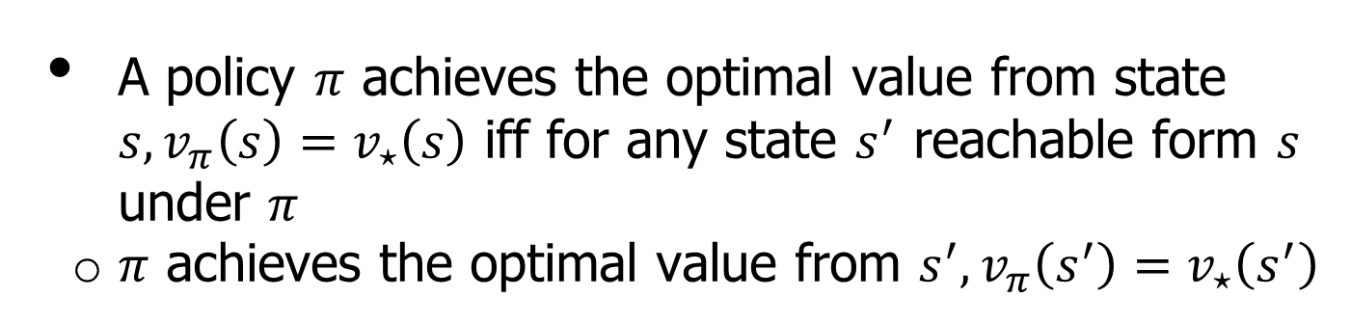

Principle of Optimality
What enables us to use iterative recursive decomposition is the principle of optimality.
Any optimal policy can be subdivided into two components:
an optimal first action $A_{⋆}$
an optimal policy from the successor state $S$
Theorem (Principle of Optimality)
A policy $π$ achieves the optimal value from state $s, v_{π}\left(s\right)=v_{⋆}\left(s\right)$ iff for any state $s^{′}$ reachable form $s$ under $π$
$π$ achieves the optimal value from $s^{′}, v_{π}\left(s^{′}\right)=v_{⋆}\left(s^{′}\right)$
8/7/2024
FIT5226-S2-2024
62/65
Notes:
If my first action is optimal, then I follow an optimal policy from next state, then the overall behavior is optimal.

Slide 63

Summary: Dynamic Programming Algorithms
Problem | Bellman Equation | Algorithm
Prediction | Bellman Expectation Equation | Iterative Policy Evaluation
Control | Bellman Expectation Equation+ Greedy Policy Improvement | Policy Iteration
Control | Bellman Optimality Equation | Value Iteration
Algorithms are based on state-value function $v_{π}\left(s\right)$ or $v_{⋆}\left(s\right)$
Complexity $O\left(mn^{2}\right)$ per iteration, for $m$ actions and $n$ states
Could do the same for action-value function $q_{π}\left(s, a\right)$ or $q_{⋆}\left(s, a\right)$
Complexity $O\left(m^{2}n^{2}\right)$ per iteration
8/8/2024
FIT5226-S2-2024
63/65

Slide 64
Take home lessons
Reinforcement learning models how (independent) agents learn about an unknown environment.
Agents learn by exploring the consequences of their actions (observed through rewards received).
Actions (can) modify the environment.
A policy describes how an agent behaves.
A value function describes how desirable an agent judges a particular environment state top be.
MRP = MC + rewards
MDP = MRP with actions determining transition probabilities
MDPs are the most fundamental modelling framework for RL
8/7/2024
FIT5226-S2-2024
64/65

Slide 65
Acknowledgments
This material includes content adapted from instructional resources made available by David Silver as part of his Reinforcement Learning course at UCL under CC-BY-NC 4.0.
Refer to https://www.davidsilver.uk/teaching/ for full details
8/7/2024
FIT5226-S2-2024
65/65

